Slide 1
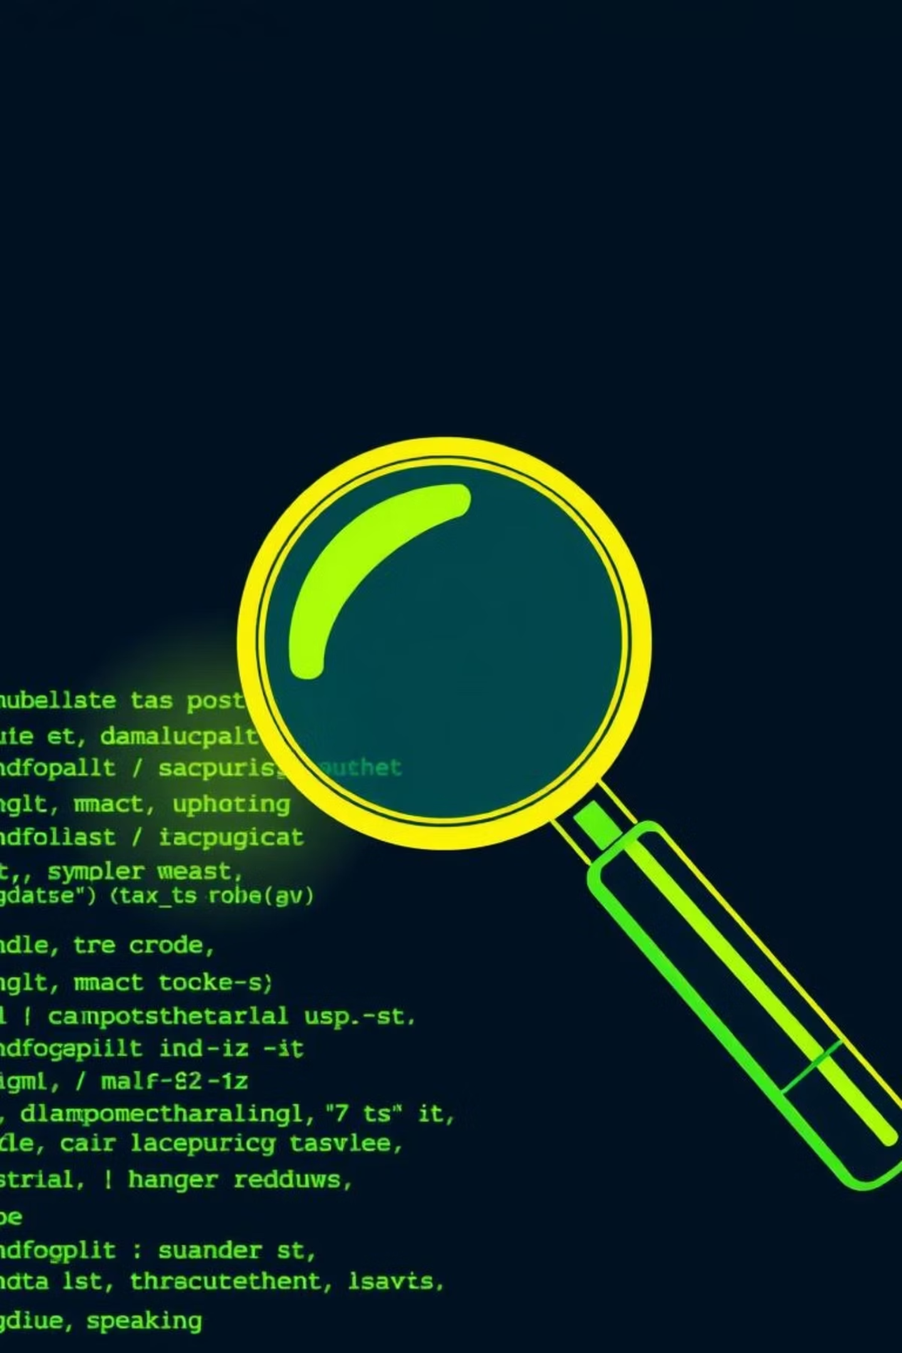


Fuzzing: Uncovering Hidden Weaknesses
Explore the power of automated vulnerability discovery.
Command Injection
Exploiting OS command execution vulnerabilities through crafted inputs.
Local File Inclusion (LFI)
Accessing sensitive server files and potentially executing arbitrary code.

Slide 2

What is Fuzzing?
Fuzzing is an automated software testing technique that systematically feeds invalid, unexpected, or random data (fuzz) as inputs to a computer program.
Its primary goal is to discover software bugs, crashes, and security vulnerabilities that could be exploited by malicious actors, often leading to system instability or unauthorized access. This proactive approach helps identify weaknesses before they become critical threats.

Slide 3




Purpose of Fuzzing: Proactive Vulnerability Management
Discover Hidden Bugs
Identify Security Vulnerabilities
Uncover subtle flaws and edge cases in code that often remain undetected by traditional manual testing methods.
Expose critical weaknesses like buffer overflows, injection flaws, and denial-of-service vulnerabilities before they can be exploited.
Stress Test Input Validation
Rigorously challenge how applications handle unexpected, malformed, or excessive inputs, pushing them to their breaking point.

Slide 4





How Fuzzing Works: A Step-by-Step Process
Prepare Wordlists
Generate or select comprehensive dictionaries of potential malicious inputs, attack patterns, and boundary conditions.
Define Placeholders
Identify specific input points within the application (e.g., 'FUZZ', 'INJECT_HERE') where test data will be programmatically injected.
Inject Test Inputs
Automatically replace the defined placeholders with each item from the prepared wordlists, systematically bombarding the target.
Monitor Responses
Analyze server responses, HTTP status codes, error messages, and application behavior for any anomalies indicating a vulnerability.

Slide 5
Examples of Fuzzing & Their Applications
Directory & File Fuzzing
Password Fuzzing
Common Vulnerabilities
These tools automate the process of testing large wordlists against web servers to discover hidden directories, files, and misconfigured paths that might expose sensitive information or entry points.
Example on file Fuzzing:
robots.txt, .env
Example on directory Fuzzing:
/admin, /backup
By attempting numerous username-password combinations, to detect weak, default, or easily guessable login credentials, which are common points of compromise.
Fuzzing and inject crafted payloads into various input fields to uncover prevalent vulnerabilities like Command Injection, Local File Inclusion (LFI), and SQL Injection.

Slide 6

Understanding Command Injection
Command Injection is a critical vulnerability that enables an attacker to execute arbitrary operating system commands on the host server where the application is running.
This occurs when an application insufficiently sanitizes user-supplied input, directly passing it to a system shell. This allows an attacker to append or inject malicious commands that the server will then execute.
Example:
ping 127.0.0.1; ls -la
If the input is not properly filtered, the ls -la command will also be executed by the server, potentially revealing sensitive directory contents.

Slide 7

Local File Inclusion (LFI)
Local File Inclusion (LFI) is a type of vulnerability that permits an attacker to include local files from the server's file system into a web application's response.
This often leads to the disclosure of sensitive information (e.g., configuration files, source code), remote code execution, or even a full system compromise if exploited effectively.
Example:
https://example.com/index.php?page=../../../../etc/passwd
This crafted URL attempts to leverage directory traversal sequences (../../) to read the system's password file from a Linux server, exposing user account information.

Slide 8

LFI: Advanced Bypass Techniques
1
Path Traversal
Utilizing ../ sequences repeatedly to navigate upwards in the directory structure, bypassing basic path restrictions.
2
URL Encoding
Encoding special characters (e.g., %2e%2e%2f for ../../) to circumvent simple string matching filters.
3
Double Encoding
Applying encoding multiple times to bypass filters that decode input only once, effectively disguising malicious characters.
4
Null Byte Injection
Appending a null byte (%00) to truncate file paths, bypassing checks for specific file extensions or allowed directories.

Slide 9
Presented by:
Supervision by DR/Nour Mahmoud
Mohamed Tamer Younes, 20235027
Mostafa Mohamed Abd-Almoaty, 20235041
Sayed Salah ElSayed, 20235059
Hesham Ashraf, 20236115

